Slide 1

June 21-22, 2024 HACKATHON
Murat Arda Onsu
Ph.D. of Computer Science
Smart Connected Vehicle Innovation Centre (SCVIC)

Slide 2
TASK: Distracted Driver Detection
Aim is to use image processing and AI methods for capturing distracted driver model
Distracted Driver: Driver uses cell phone on the road
Codes will be written in Python environment. Minimum Requirements:
Jupyter Notebook
torch
torchvision
matplotlib
pandas
cv2

Slide 3
Models & Methods
Image Processing methods will be used
2 AI Algorithms:
Object Detection: Pre-trained Yolov5 model will be given (no need to train)
Classification: you can use benchmark model or custom model
Inputs: RGB images
4 different parts

Slide 4
Part 1: Privacy & Image Blurring
Dataset Preparation for object detection
Image dataset are in "IMAGES" directory:
IMAGES/0 : Non cell phone usage
IMAGES/1 : Cell phone usage
Dataset image annotation is stored two coco files:
Coco_1.json & Coco_2.json
Note that image annotation (regardless of its label) can be either Coco_1.json or Coco_2.json

Slide 5
Part 1: Privacy & Image Blurring
4 different categories and their id:
Cell Phone --------------> id: 1: (if person holds cell phone)
Face-----------------------> id: 2: (person’s face)
Hand ---------------------> id: 3: (Persons hand)
OOD ----------------------> id: 4: (Out of Domain)
Cell Phone Attached --> id: 5: (if cell phone is not person’s hand)
Each image bounding box coordinates (x1,y1,x2,y2,x3,y3,x4,y4) are in coco files.
Task: Blurring Face (id=2) without changing Cell Phone (id=1) ’s bounding box (fill Part-1.ipynb), Save new images
Note: if image original source is folder 0 then save it new folder 0 and same for folder 1

Slide 6
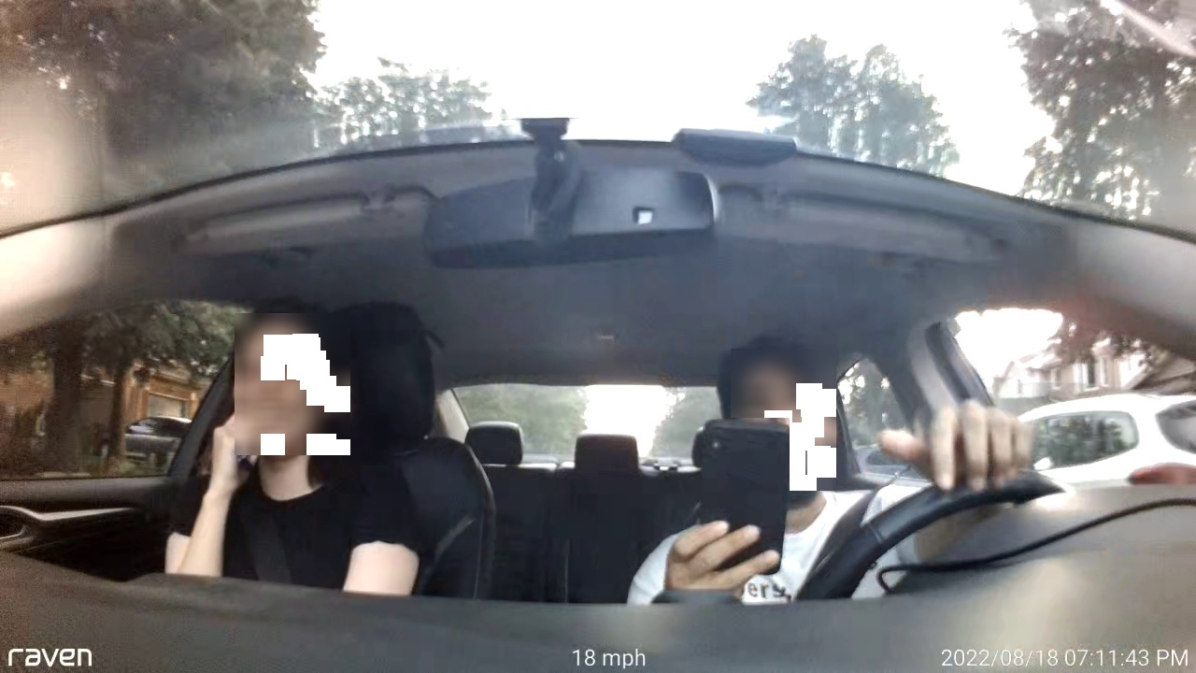
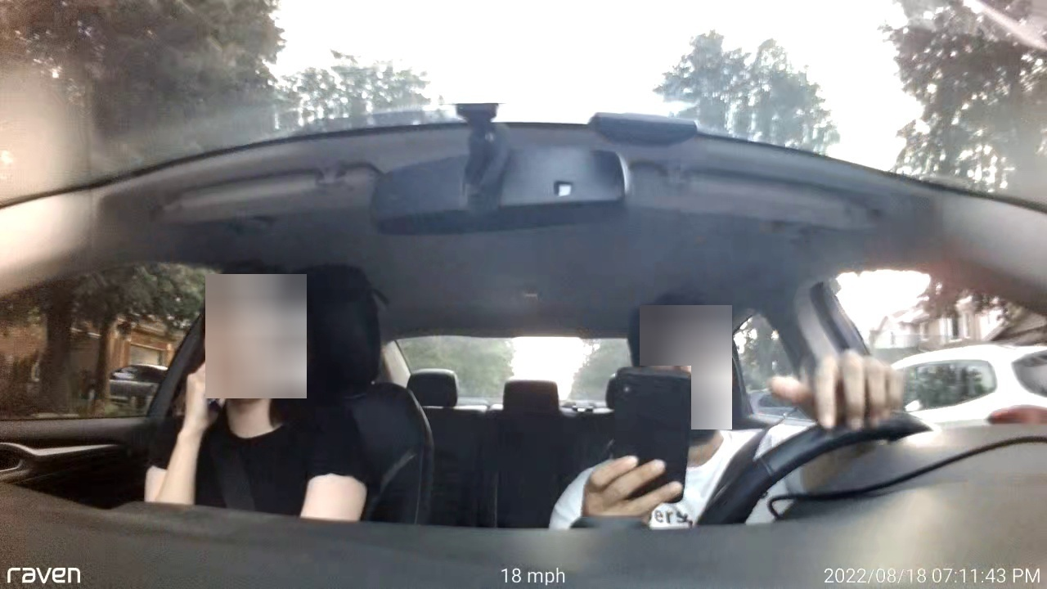
Part 1: Privacy & Image Blurring
Cell Phone Face
Cell Phone and Face Coordinate in coco file

Slide 7
Part 2: Post processing
You are asked to pass blurred images from Part-1 to pretrained YOLOv5 model and see the results with bounding box.
It is important to note that driver and passenger must be seperated from the model output.
Therefore, model labels: Cell Phone and Face should be relabelled after model output
Face: Driver or Passenger
Cell Phone: Driver Use of Passenger Use

Slide 8
Part 2: Post processing
First "Face" will be change then it is followed by "Cell Phone"
If:
Number of face annotation is 1: Driver
Face bounding box are is smaller than 5000: Passenger (back Passenger)
If face is on the left halve: Passenger – right halve: Driver
For Cell Phone:
If cell phone bounding box is close to Driver annotation: Driver Use
If cell phone bounding box is close to Passenger annotation: Passenger Use
Part-2: Save images with new labelled bounding boxes. If "Driver Use" label exists save it directory "PROCESSED/1" else save it "PROCESSED/2"
(You can use any color for new bounding box) (fill Part-2-3.ipynb)

Slide 9
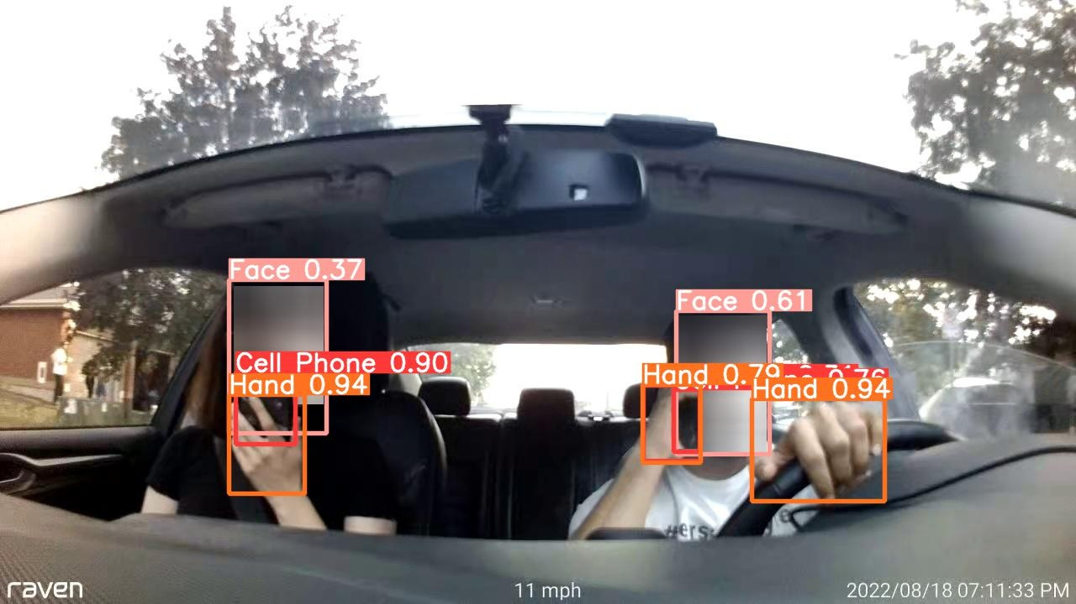
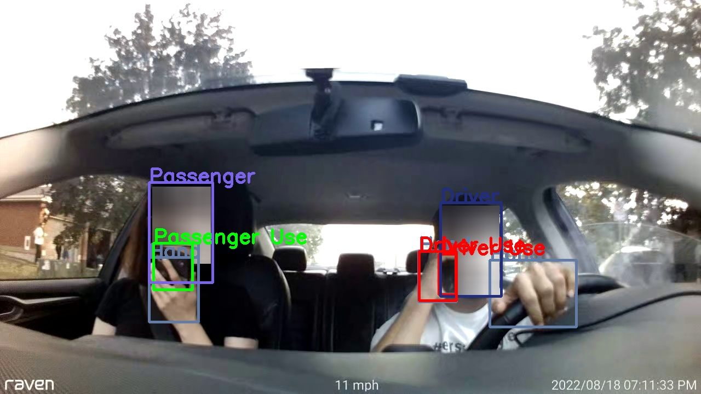
Part 2: Post processing
YOLOv5 Output
Relabelled Images

Slide 10
Part 3: Cell Phone Extraction
Put images from Part 1 YOLOv5 model again
Get "Cell Phone" (regardless of Driver or Passenger Use) and "Cell Phone Attached" Bounding Box for each image
Extract these bounding boxes in circle shape, radius is the 0.75*{longest_edge}
NOTE: you are only allowed to use data structures such as numpy.
Save these phone images to new directory:
Cell Phone: "PHONE/1"
Cell Phone Attached: "PHONE/0"
(fill Part-2-3.ipynb)

Slide 11
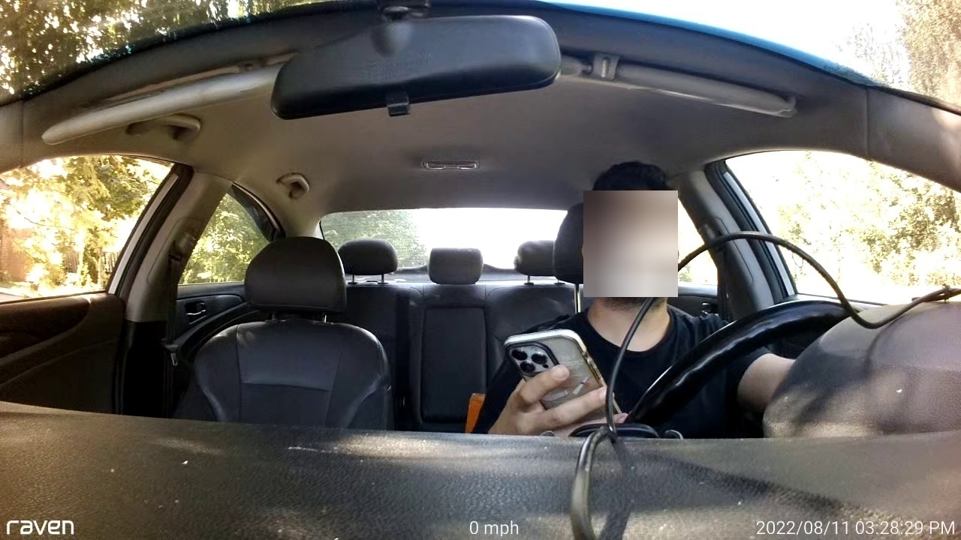
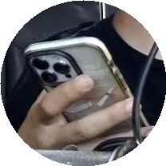
Part 3: Cell Phone Extraction
Cell Phone
(Model Prediction)

Slide 12
Part 4: Binary Cell Phone Classification
Create custom model or benchmark model for binary classification.
Get Cell Phone (1) and Cell Phone Attached (0) images from part-3
Split data 75% Train and 25% Test
Make binary classification
Draw confusion matrix and accuracy-loss graph during the training
Create jupyter notebook Part-4.ipynb and write your code there

Slide 13
NOTE
You can import additional libraries (except for Part-3 drawing circle)
You can follow these hints or rewrite the code yourself
Save your code file: Part_{n}_Group_{group_number}.ipynb

